Slide 1
WEBSERVER AND APPSERVERS

Slide 2
WEBSERVER:
Web servers will help us to manage / deploy statis websites
Types of webservers:
apache http
Nginx

Slide 3
APP servers
App servers are used to deploy the dynamic websites.
Types of appservers
apache tomcat
jboss
weblogic

Slide 4
Difference between webserver and appserver
Both are web servers and used to deploy/serve static content.
Nginx is faster than apache.
Nginx can be used as load balancer and no extra configurations are required.
Apache can be used as load balancer and extra configurations are required.

Slide 5
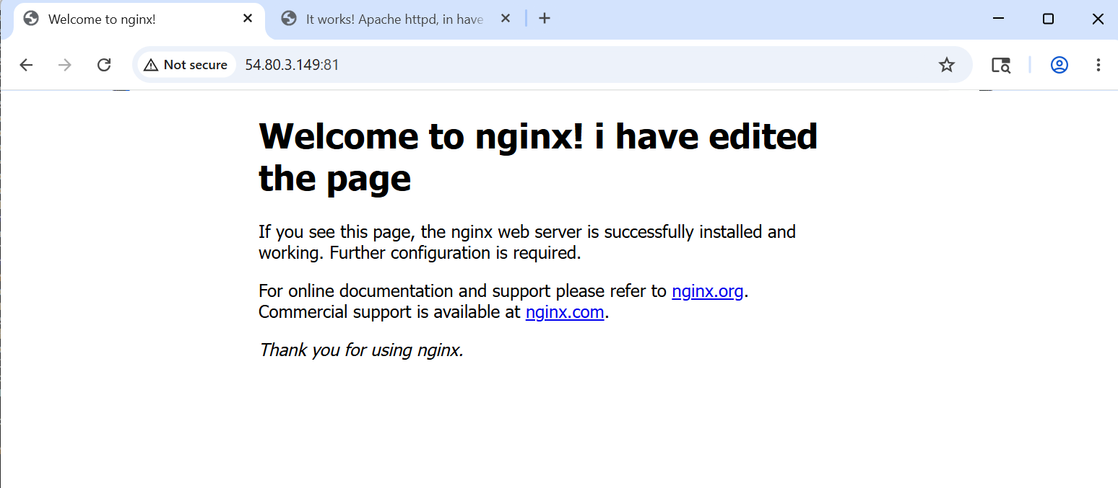
Install nginx and run nginx on port number 81
Yum update –y
Yum install nginx –y
Default port number : 80
To change the port number from 80 to 81, we have to configure the /usr/nginx/nginx.conf
Default deployment location /usr/share/nginx/html, to deploy a sample app we have to edit the index.html file
Systemctl enable nginx
Systemctl start nginx
Systemctl status nginx

Slide 6
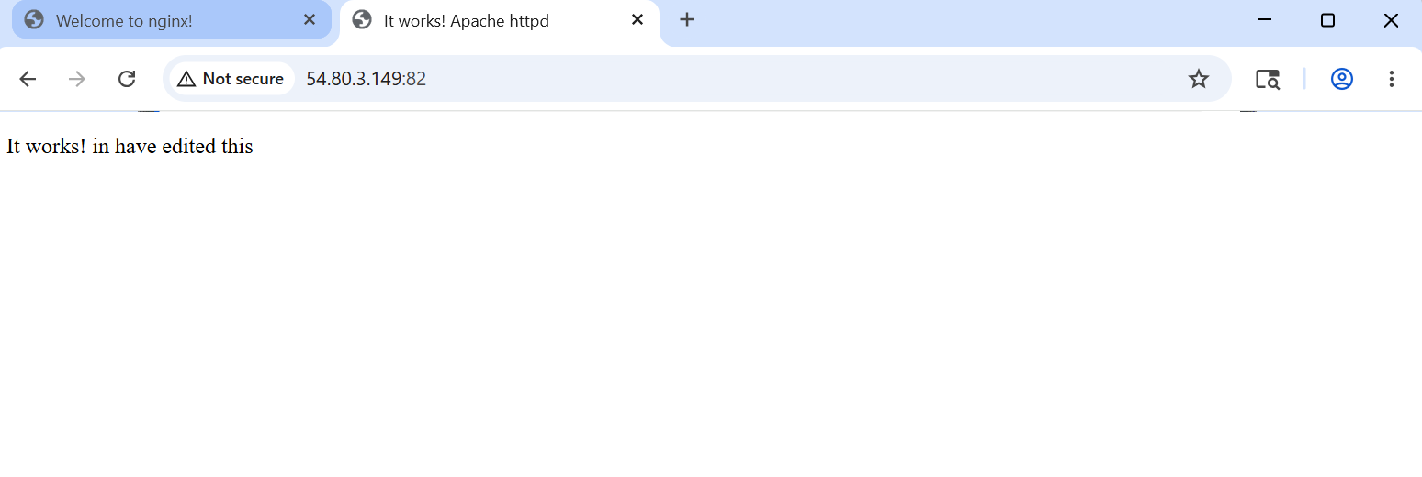
Install apache and run apache on port number 82
yum update –y
Yum install httpd
Default port number : 80
To change the port number from 80 to 82, we have to configure /usr/httpd/httpd.conf
Default deployment location /usr/share/httpd/html, we have to edit the index.html
systemctl enable httpd
systemctl start httpd
systemctl status httpd

Slide 7
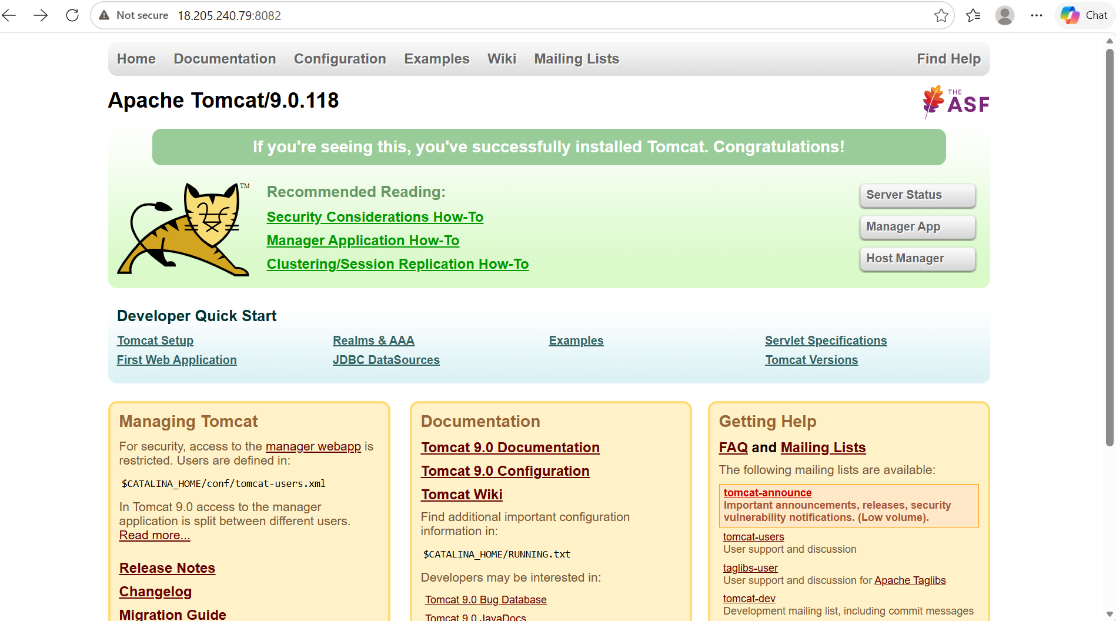
Install apache tomcat on port number 8082
Firstofall download java version 17 -> yum install java-17
And then download tomcat using wget url-to-the-tomcat
Extract the downloaded file by using tar command ->
Tar xvf downloadedfile
use the startup.sh command to run the tomcat
Change the port number 8080 to 8082 in /opt/tomcat/conf
then execute commands shutdown.sh and startup.sh

Slide 8
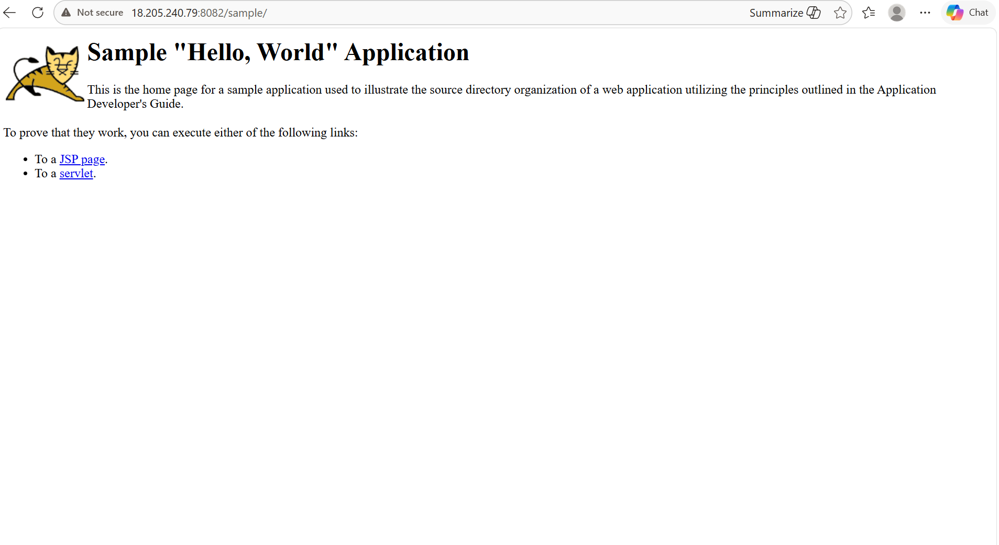
Deploy a sample app on webapps
/opt/tomcat/webapps
Download the sample war file from web by using wget
We can access this by publicip:8082

Slide 9
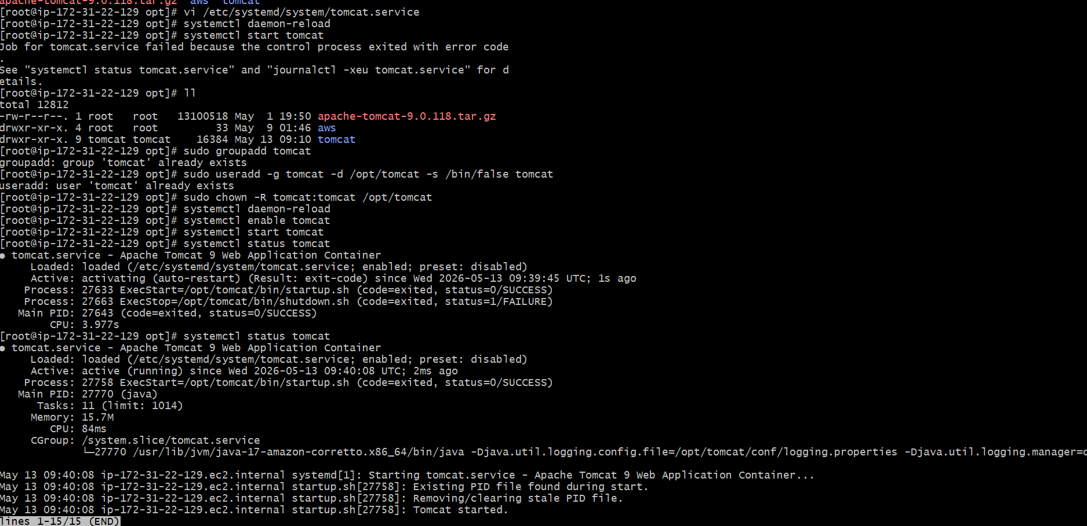
Create a tomcat.servicefile for tomcat
Create tomcat.service file in /etc/system/system
Add a user tomcat by adduser command and change the ownership of the downloaded tomcat file to tomcat user
systemctl daemon-reload
systemctl enable tomcat
systemctl start tomcat
systemctl status tomcat

Slide 10
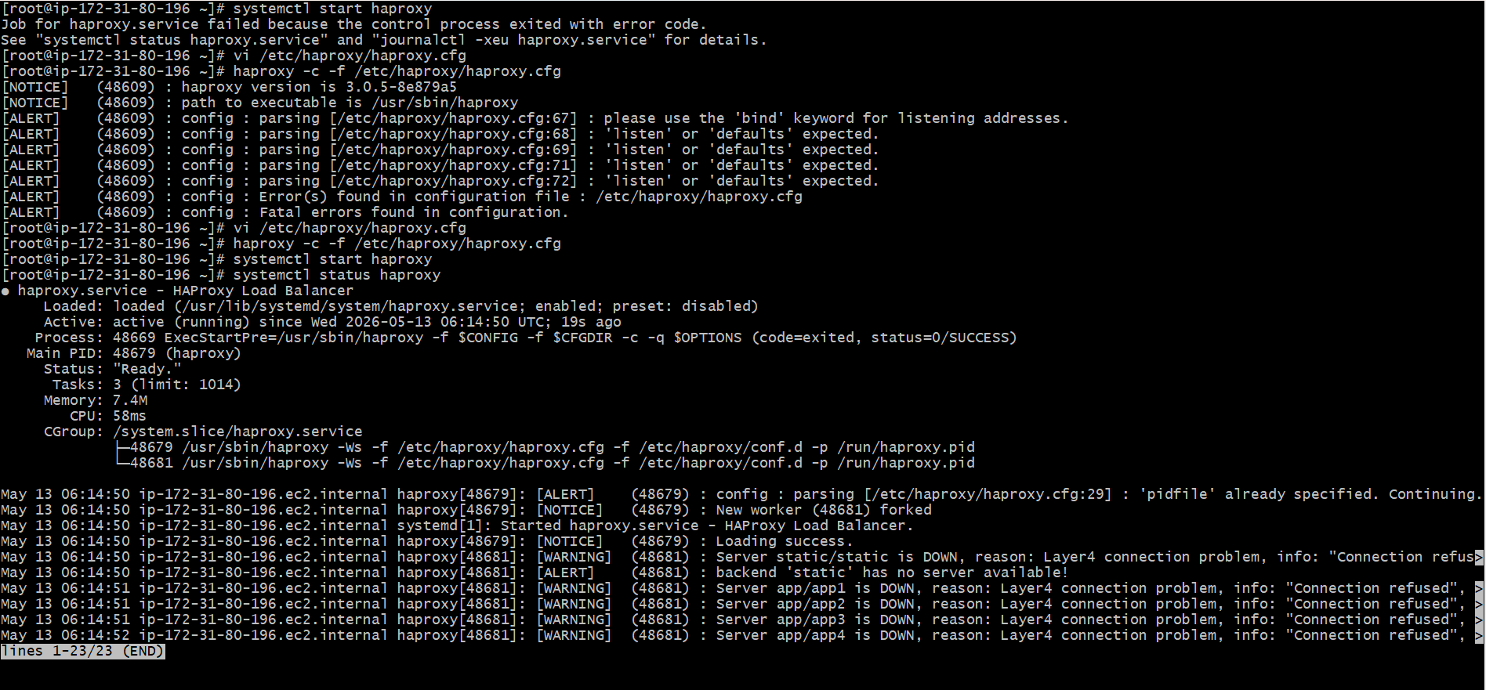
Configure haproxy server
Launch 3 instances server1, server2 and haproxy server
Configuration of server1 and server2 are same and add publicip of haproxy server as loadbalancer
On server1 launch httpd service and on server2 launch nginx service
Run ping command on both servers to create a connectivity with haproxy server
Add public ips of both servers in haproxy.cfg file

Slide 11
THANK YOU

